Slide 1
Math club designs

Slide 2
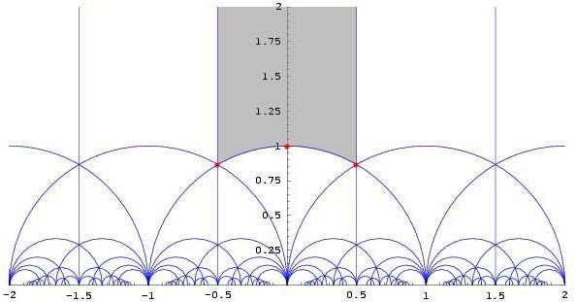
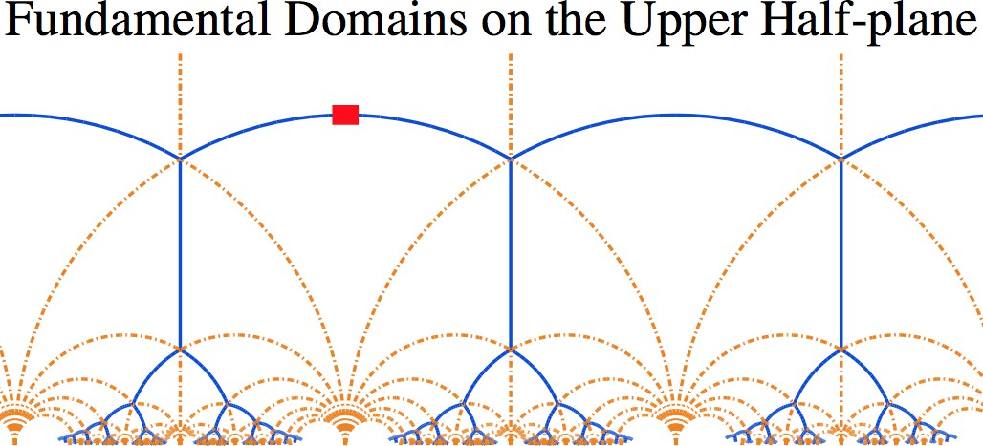
Fundamental domains
used in geometry to represent a shape that, when repeated in certain ways, fills up a bigger space without any overlaps or gaps.
Imagine a tile on the floor: its fundamental domain is the smallest part of the tile that, when repeated, covers the entire floor without leaving any spaces in between.
fundamental domains are important for studying symmetry, tiling, and understanding shapes in different dimensions.
They're like the building blocks that help us explore and understand how shapes fit together in various patterns.

Slide 3
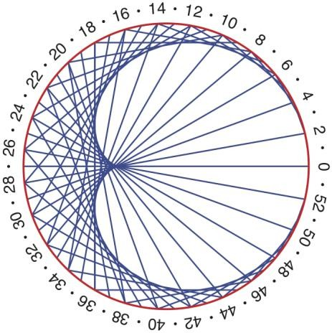
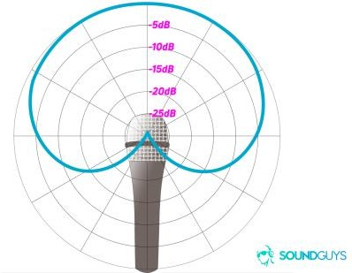
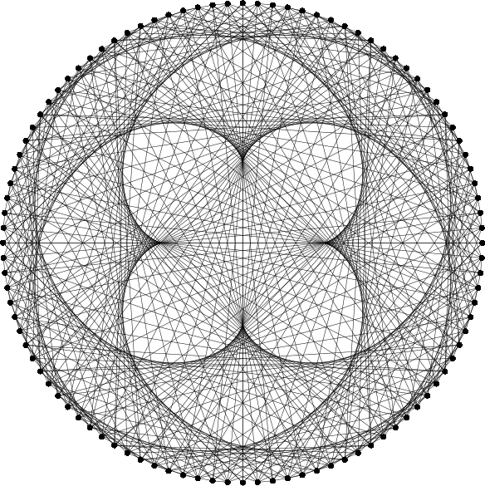
cardiods
They are a specific form of the mathematical shape called an epitrochoid.
r = a ± cosθ i
Mathematically, they're defined as the set of points traced by a fixed point on a circle as that circle rolls around another fixed circle.
Cardioids have applications in physics, engineering, and various areas of mathematics, especially in geometry and calculus.
They appear in different natural phenomena and are used in designing curves for specific functions or aesthetic purposes.

Slide 4
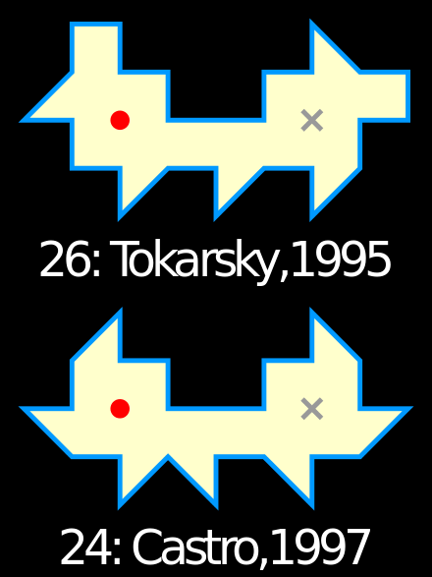
Tokarsky’s unillumanable room
Tarski's unilluminable room challenges the idea that any enclosed space can be entirely lit.
It envisions a room where, regardless of light placement or quantity, certain areas always remain in shadow.
This concept explores limitations in illuminating certain geometric spaces.
It highlights the complexities of light distribution within confined areas.

Slide 5
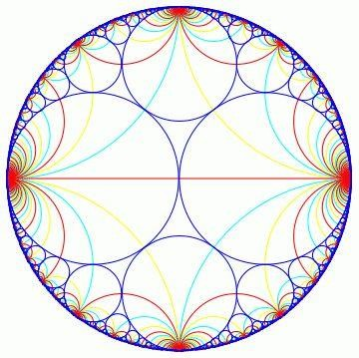
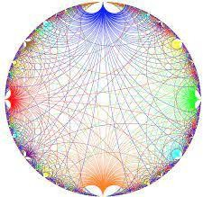
Farey diagrams
Farey diagrams depict fractions between 0 and 1 in order from smallest to largest denominators.
They show all irreducible fractions within a given range.
Each point represents a fraction, illustrating their relative sizes and relationships.
Useful in number theory, studying approximations, and understanding rational numbers' patterns.

Slide 6
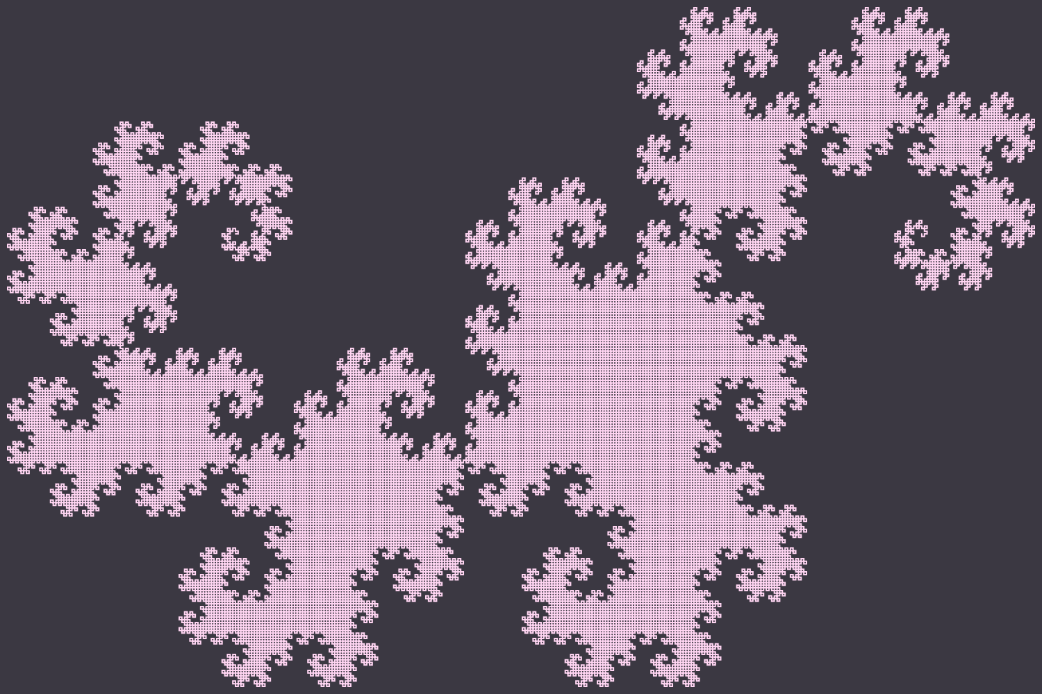


Dragon curve
Epic cool very awesome fractal

Slide 7

Julia sets
The Julia set is generated by iterating a complex function f(z) = z^2 + c, where z is a complex number and c is a constant complex number. The Julia set is the boundary between points that either escape to infinity or remain bounded under iteration of this function.
Another epic cool fractal
The Mandelbrot set, on the other hand, is a set of complex numbers
c for which the iterative process (z) = z^2 + c does not escape to infinity when iterated from z=0.

Slide 8

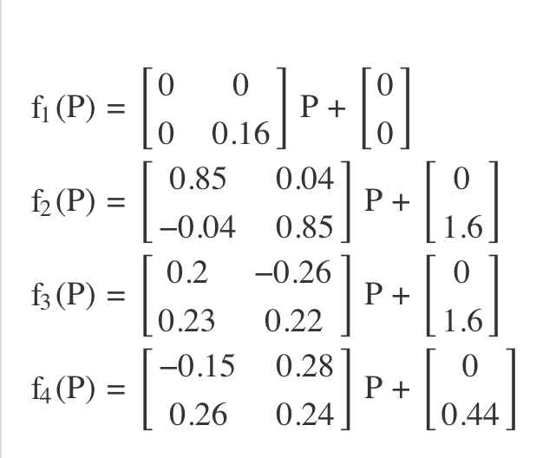
Barnsley fern
Another fractal

Slide 9
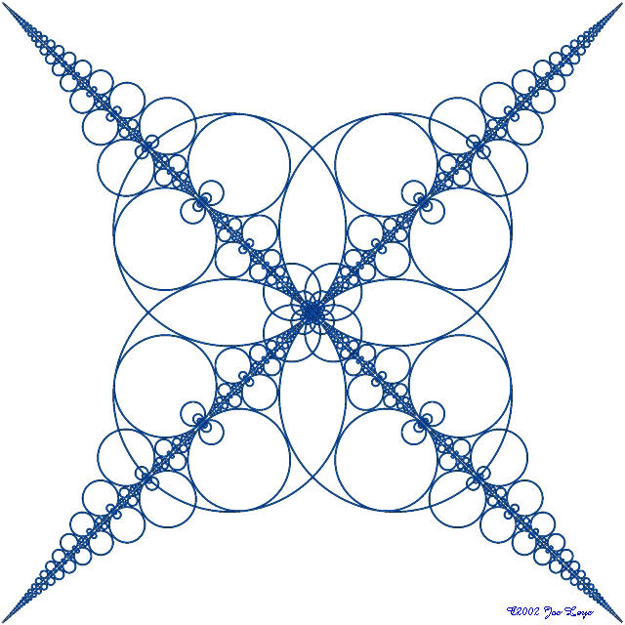
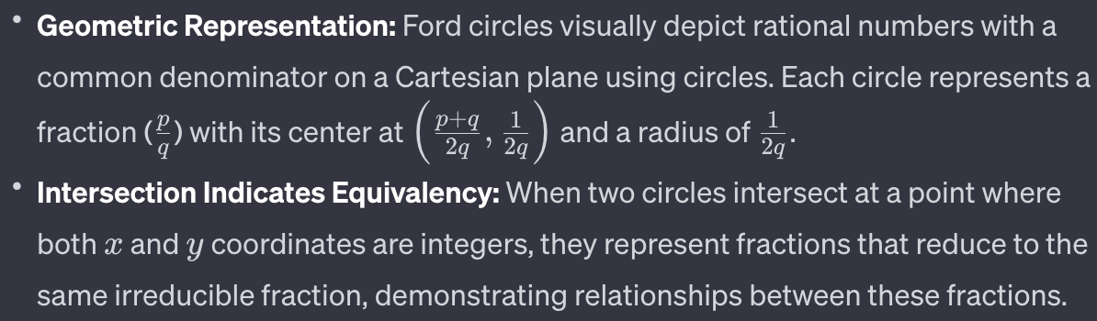
Ford Circles

Slide 10
voting
Farey diagrams
Tokarsky’s
unillumanable room
cardiods
Fundamental domains
Ford Circles
Dragon Curve
Barnsley Fern
Julia sets

